Slide 1
RANDOM GRAPHS

Slide 2
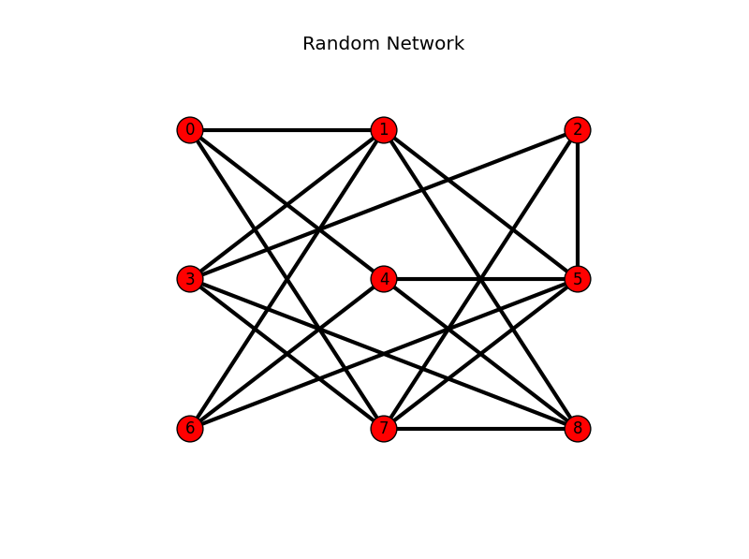
What is Random Graph
A random graph is a graph in which properties such as the number of graph vertices, graph edges, and connections between them are determined in some random way.
A random graph is obtained by starting with a set of n isolated vertices and adding successive edges between them at random.
This Photo by Unknown Author is licensed under CC BY-SA

Slide 3
Erdos Renyi simple random model
ASSUMPTIONS
Nodes connect at random
Network is undirected
Key Parameters(other than no. of nodes N)
p=probability that any 2 nodes share an edge {G(N,p) model}
L=total no. of links in the graph {G(N,L) model}

Slide 4
Models
G(N,p) Model
G(N,L) Model
Each pair of N labelled nodes are connected with probability p
Introduced by Gilbert
Number of edges are not fixed
Eg:For each unique pair (i,j), flip a coin
head has probability (p)→ create an edge btw i,j
tail with prob (1-p) → donot create an edge
Get different graphs each time
N labelled nodes are connected with L randomly placed links
Introduced by erods and renyi
Number of edges are fixed
Eg:Randomly connecting nodes based on L
L=N(N-1)/2

Slide 5
How to draw a random graph
We can generate random graphs using python

